Slide 1
Cymer-scan
Sagiv Antebi ,Uri Greitser, Ben Ganon, Omri Ben Hemo,

Slide 2

Our mission
Detect the exact snapshot a file has been encrypted and return a list of those files.

Slide 3
How we started
- We analyzed how an encrypted file looks like
- We thought of a few different ways to detect the infected files
- We combined those methods to one single algorithm

Slide 4



ALGORITHM FLOW
Check for changes in a file between snapshots – Date + Time
Run The Algorithm
Present findings with GUI

Slide 5


STEP 1
Check for changes in a file between snapshots – Date + Time

Slide 6

STEP 2
We Check file endings
And apply each a different filter
image
Compare the bytes

Slide 7
STEP 2
We Check file endings
And apply each a different filter
Text,XML, etc
ASCII Check

Slide 8
STEP 2
We Check file endings
And apply each a different filter
Else
Entropy

Slide 9
STEP 3
Sum it up
Compare against our threshold

Slide 10
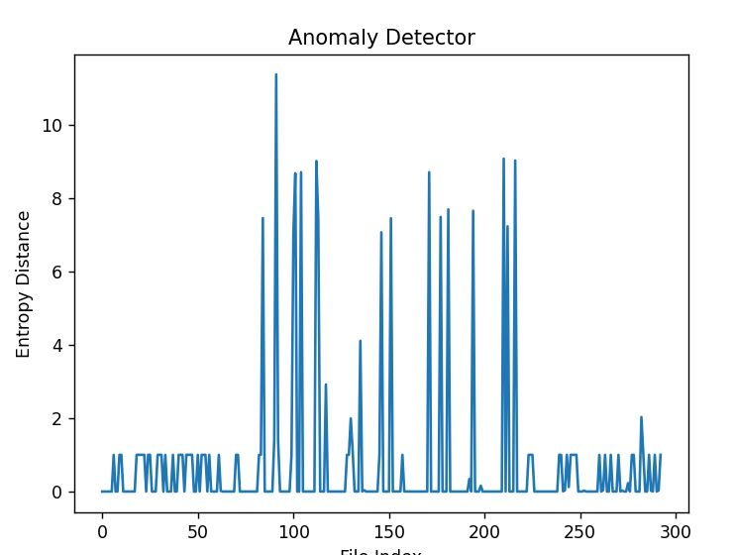
Results

Slide 11

Example Run

Slide 12
Thank you!

